Slide 1









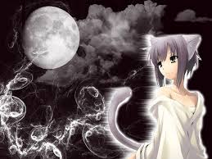
Cuddington & Sandiway
Community Singers
Logo
(h1)
Rollover
Buttons
(h2)
Home
(h4)
This is here to caption pictures
Heading 3
This is some text used to make an example of the paragraphs which will be used within the website I am composing, the size will be 18px, colour will be black and the text will be Verdana.
(p)
I’ll be honest, this picture is a blast from my past which I am not happy about whatsoever, I am not sure why I chose to use this picture, but no matter the reason, there will be a picture in the top left hand corned of each of the pages.
(p)
<p> = Black, 15px, Verdana.
<h4> = Black, 12px
<h2 class title> = colour: #00B0DC, <h2> = 24px (B)
<h3> = black, 18px (B)
<h1> = Black, 44px, aligned right.
Background colour IN = #FCD5B5
Background colour OUT = #A6A6A6

Slide 2
Cuddington & Sandiway
Community Singers
Home
A Dream Within a Dream
Home is Where the heart is!
Take this kiss upon the brow! And, in parting from you now, Thus much let me avow — You are not wrong, who deem That my days have been a dream; Yet if hope has flown away In a night, or in a day, In a vision, or in none, Is it therefore the less gone? All that we see or seem Is but a dream within a dream.
I stand amid the roar Of a surf-tormented shore, And I hold within my hand Grains of the golden sand — How few! yet how they creep Through my fingers to the deep, While I weep — while I weep! O God! Can I not grasp Them with a tighter clasp? O God! can I not save One from the pitiless wave? Is all that we see or seem But a dream within a dream?

Slide 3

Cuddington & Sandiway
Community Singers
About Us
The Shadow over Innsmouth
Learn about our great establishment
During the winter of 1927-28 officials of the Federal government made a strange and secret investigation of certain conditions in the ancient Massachusetts seaport of Innsmouth. The public first learned of it in February, when a vast series of raids and arrests occurred, followed by the deliberate burning and dynamiting - under suitable precautions - of an enormous number of crumbling, worm-eaten, and supposedly empty houses along the abandoned waterfront. Uninquiring souls let this occurrence pass as one of the major clashes in a spasmodic war on liquor.

Slide 4
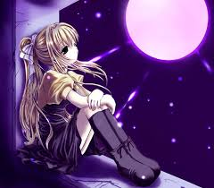
Cuddington & Sandiway
Community Singers
Diary Page
Learn when events and Practice is!
This is the Calendar for the singing thing and it is pretty good I guess.
SEPTEMBER 2014
Mon | Tue | Wed | Thu | Fri | Sat | Sun
25 | 26 | 27 | 28 | 29 | 30 | 31
1 | 2 | 3 | 4 | 5 | 6 | 7
8 | 9 | 10 | 11 | 12 | 13 | 14
15 | 16 | 17 | 18 | 19 | 20 | 21
22 | 23 | 24 | 25 | 26 | 27 | 28

Slide 5
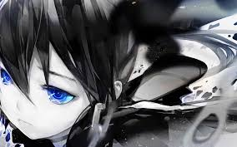

Cuddington & Sandiway
Community Singers
Pictures
Hansel and Gretel
Picture of our time together!
Jack and Jill went up the hill and were never seen again. The End.
Nananananananananananananana… wait, wrong superhero.

Slide 6
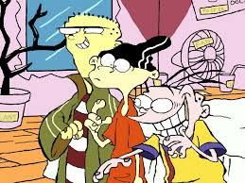
Cuddington & Sandiway
Community Singers
Contact Us
SO Painful!!
Get in touch!
I’m done! After all this damn story finding and sad anime picture search, I am done! I’m gone! It took a whole lesson finding those pictures and stories and it was stressful because I have a lot to do, If I do not complete this unit to the max I can, I am killing someone. I am not sure who, or what, but I will kill someone.
I know this is a little morbid but man it is painful having to do all this…
I’m done.
I’m out.
Gone.
Later…
Have fun!

